Slide 1


Roasting Google APIs on
Firebase to create Uberritos
By Ishan Khanna
Android @ Booking.com
@ishan1604

Slide 2



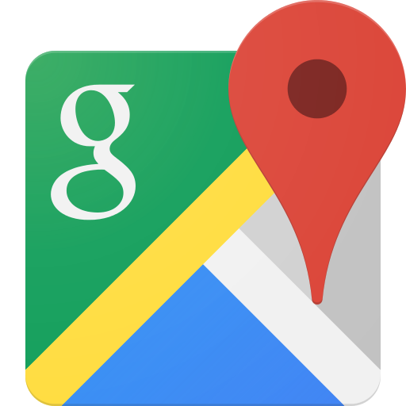
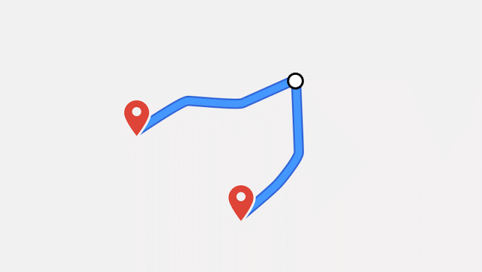

Agenda
A Deep Dive into
A Glance over
An Uber like app as a case study
Firebase

Slide 3
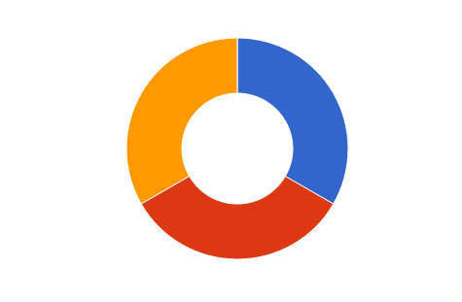
Firebase Overview
Grow
Develop
Acquisition
Dynamic Links
Invites
Re-Engagement
Notifications
App Indexing
Backend Services
Real time DB
Authentication
Hosting
Storage
Cloud Messaging
Remote Config
App Quality Services
Test lab
Crash Reporting
Analytics
Earn
In-App Ads

Slide 4
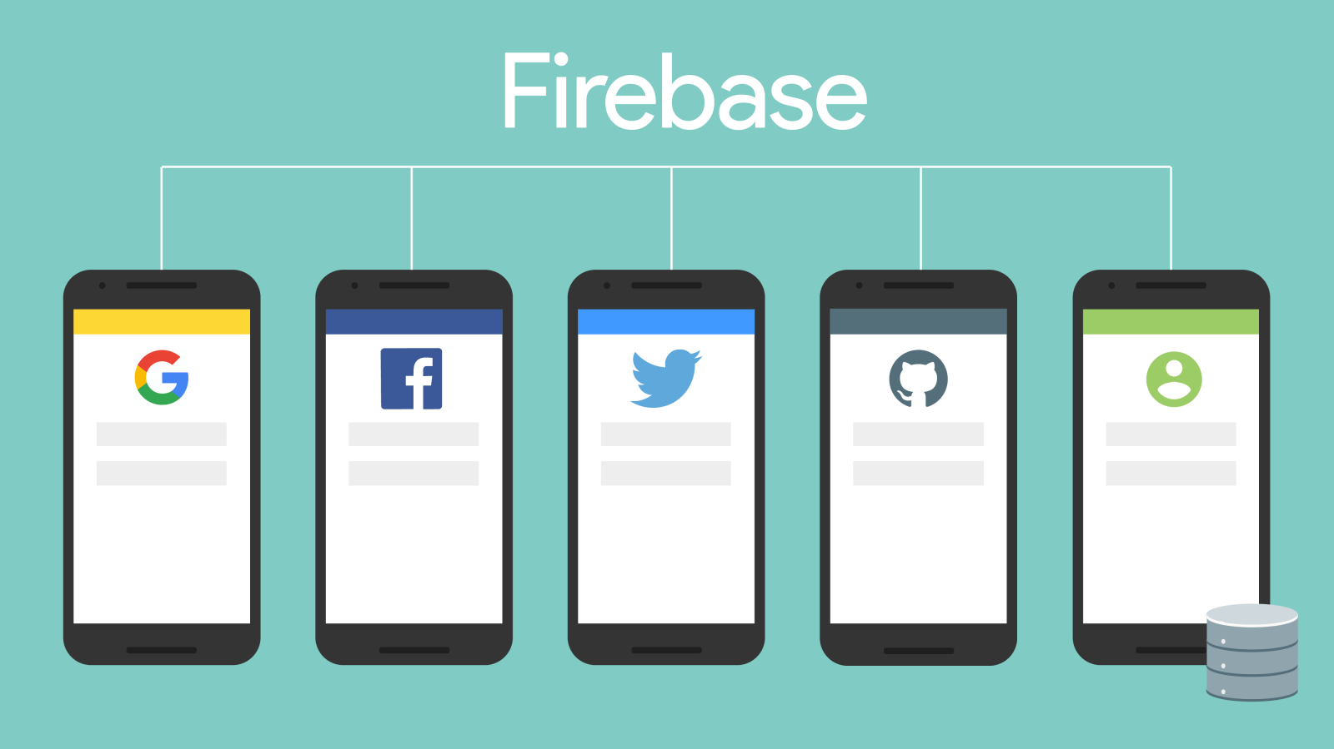

Authentication
Support for :
Email & Password
Social providers
OAuth2
Anonymous Login
Any other existing solution
Firebase UI - Drop In Authentication Solution

Slide 5
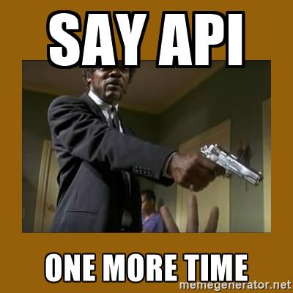

So let’s write our app? Where’s the API?

Slide 6


Real time Database
Cloud-Hosted NoSQL database
Synchronization & conflict resolution
Access directly from your app
Storage in JSON format

Slide 7
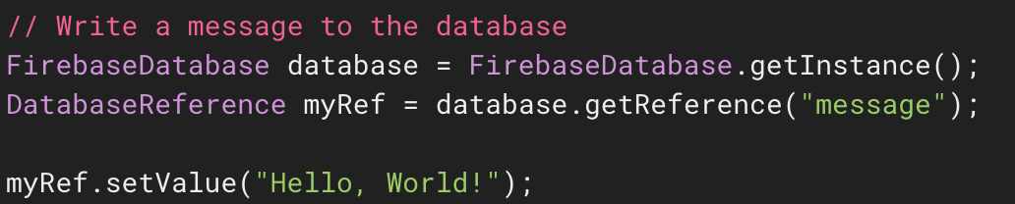

Slide 8
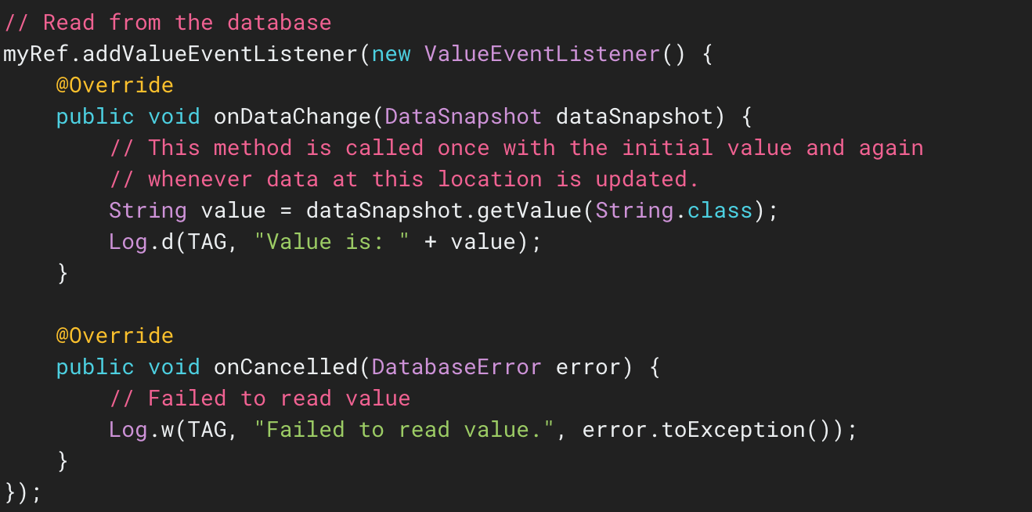

Slide 9




The Rider - Driver Communication
+
Queries for
Nearby Drivers
Update
Notes:
There is a reason why I specifically mentioned location + metadata for drivers - we’ll get onto that later in the presentation !!

Slide 10
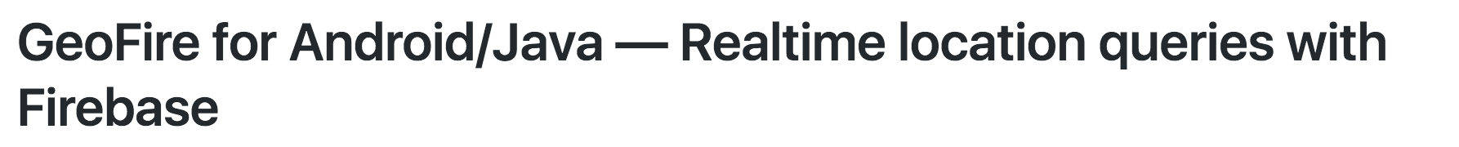
The Query Problem
How do I query for drivers near me?
You said it’s NoSQL, so am I going to fetch everything?
Allows queries within geographical area
Has capabilities for selective loading
Stores data in its own format

Slide 11

Querying with GeoFire

Slide 12
Getting results from Geofire : Geofire Events
Key Entered : onKeyEntered(String key, GeoLocation location)
Key Exited : onKeyExited(String key)
Key Moved : onKeyMoved(String key, GeoLocation location)
Query Ready : onGeoQueryReady()
Query Error : onGeoQueryError(DatabaseError error)
Notes:
Key Entered: The location of a key now matches the query criteria.
Key Exited: The location of a key no longer matches the query criteria.
Key Moved: The location of a key changed but the location still matches the query criteria.
Query Ready: All current data has been loaded from the server and all initial events have been fired.
Query Error: There was an error while performing this query, e.g. a violation of security rules.

Slide 13
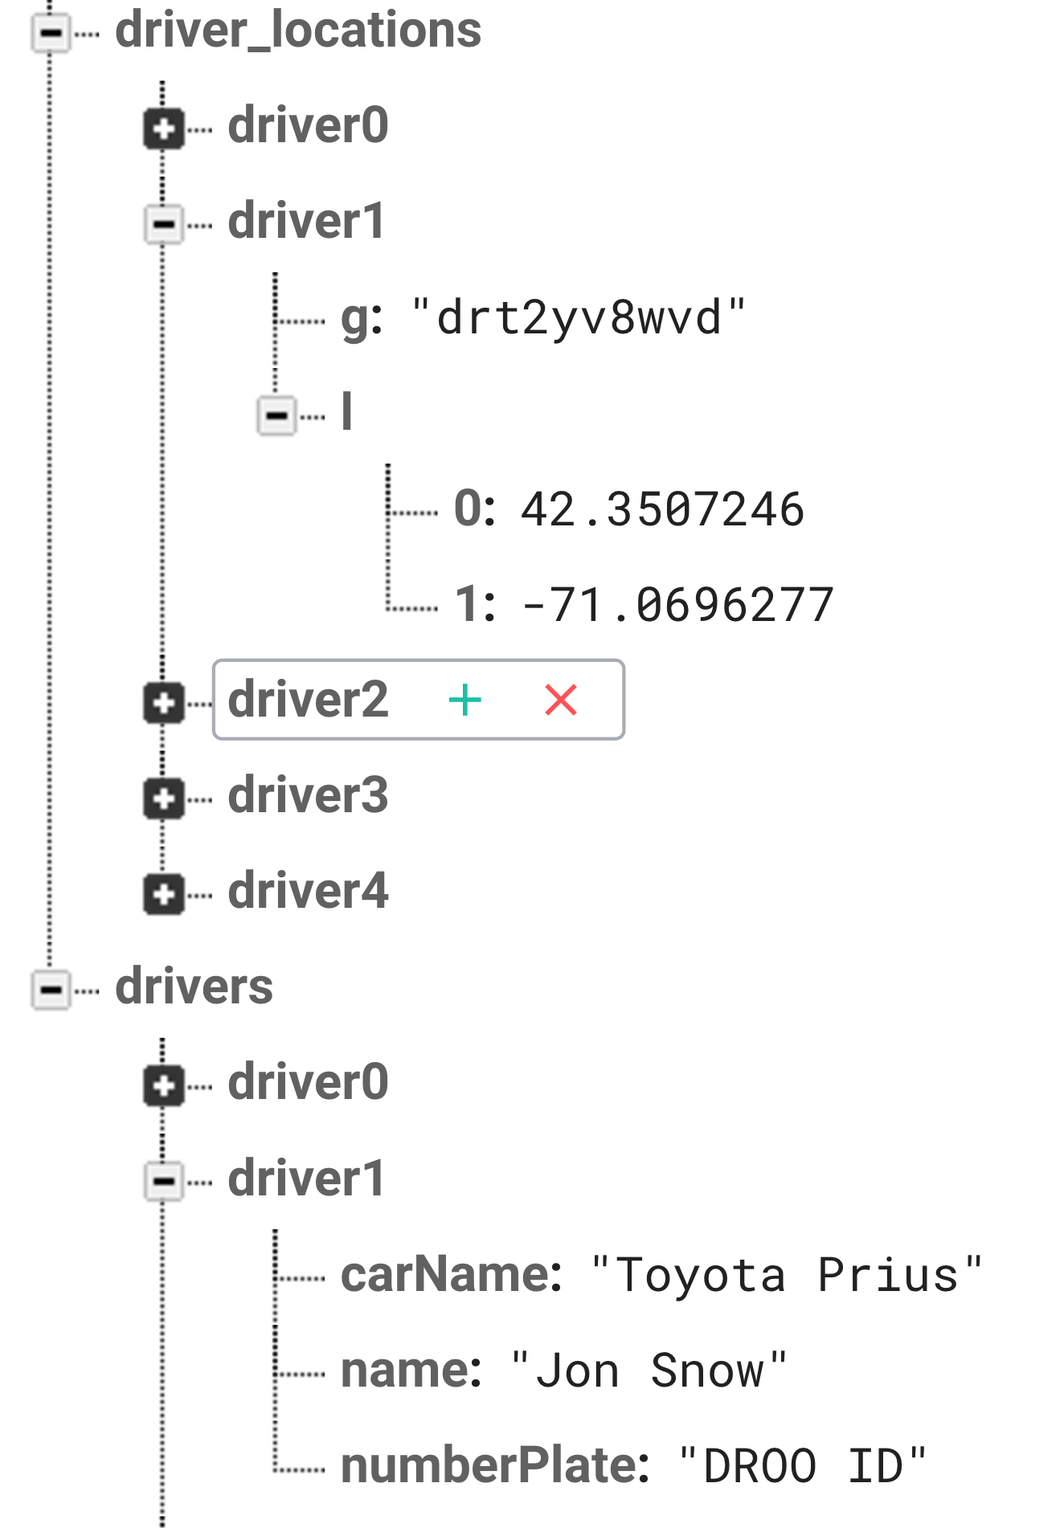
Geofire Data Storage Sample

Slide 14
Don’t forget it’s NoSQL
Avoid Nesting Data Structures
Flatten Data Structures
Create data that scales

Slide 15
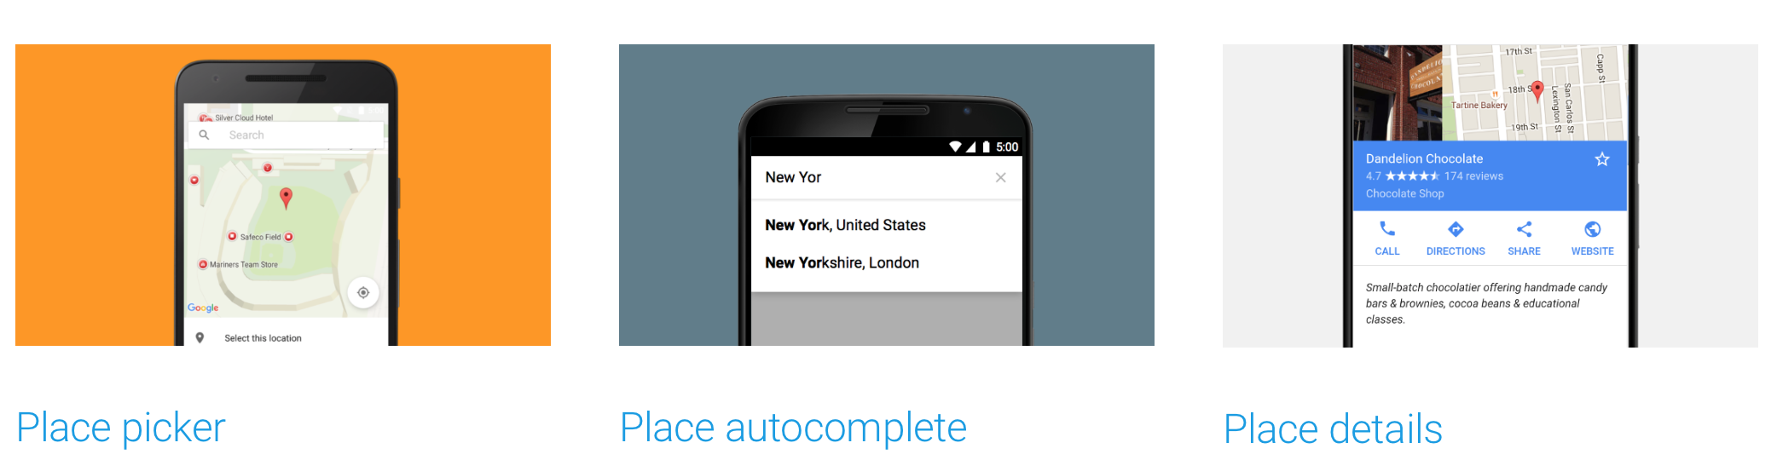
Choosing the destination
Location Aware
Global Search - Shops, Bars, Cafes etc.
Autocompletion features like on GMaps
Ready to use Activity and Fragment Widgets

Slide 16
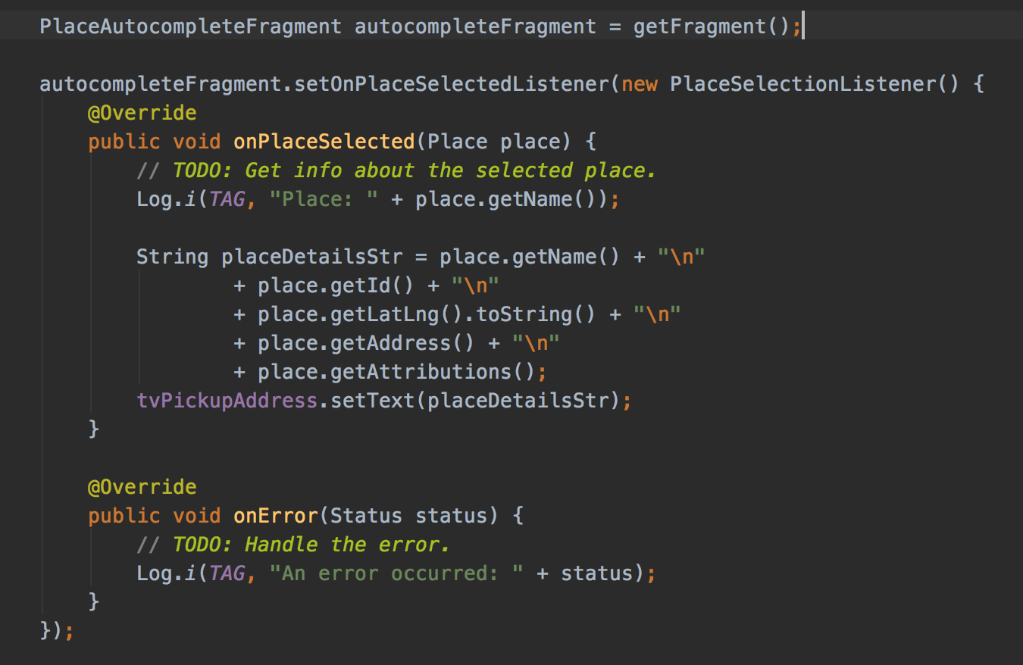
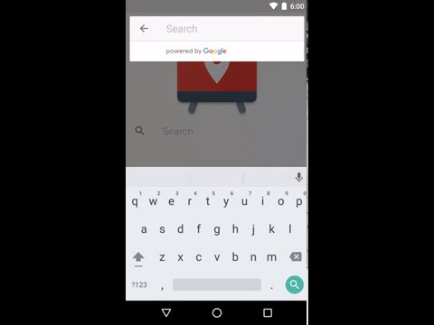

Slide 17
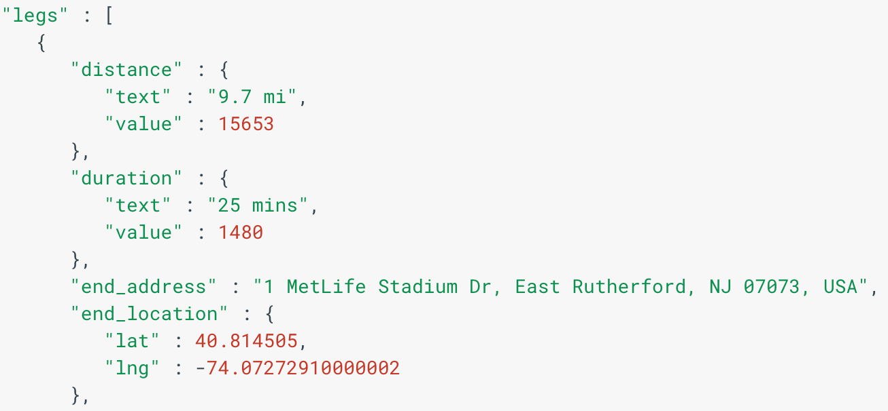
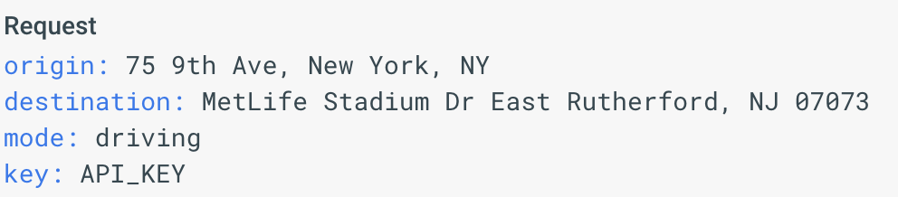
Finding your way...
Using Google Maps Web Services > Directions API
Iterate through all the legs and add up the duration values to get estimated travel time.

Slide 18
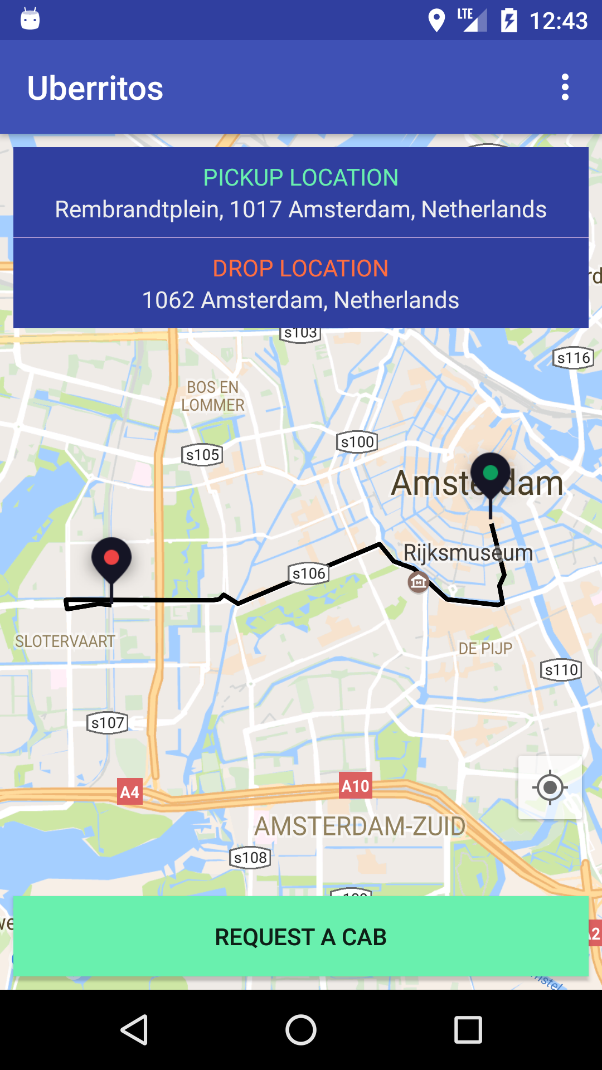
Displaying the route
"overview_polyline":{"points":"knaChDeBlDiAdD}{GvM_DjFkBzBsB`BqDhBaEfAsTvEmEr@iCr@qDrAiFnCcEzCaE~D_@JmFdGQDwBvCeErEoD|BcFjC}DbEuD~D`@Zr@h@?d@Wr@}@vAgCbEaHfMqA`Cy@dAg@bAO`@gCi@w@W"},
Encoded Polyline in response
Easily decode the Polyline to get LatLng Object
Plot the route using PolyLineOptions of the Google Maps API on Android
Notes:
Introduce Remote config

Slide 19

Hosting & Storage
Easy File Storage
Serve Static Assets
Handles poor connectivity
Backed by & accessible from Google Cloud Storage
Support for Images & Videos too
SSL Encryption by default

Slide 20
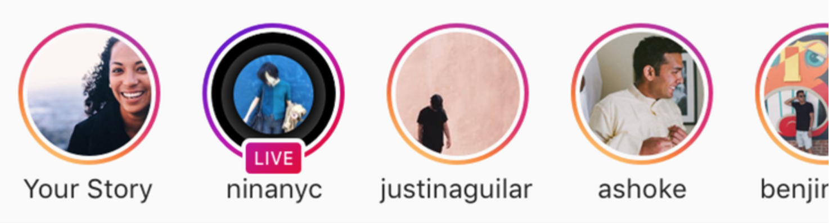
Don’t forget - You can also add Stories

Slide 21
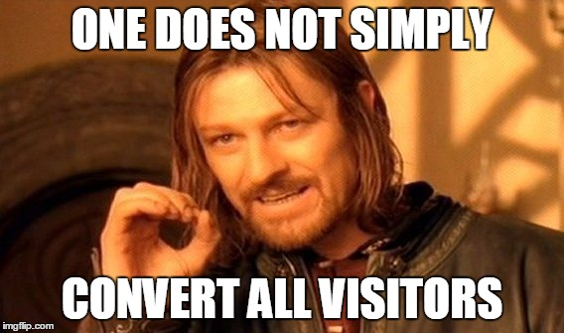
Remote Configurations
A/B Testing
Staged Roll out of Features
Direct integration with Analytics

Slide 22
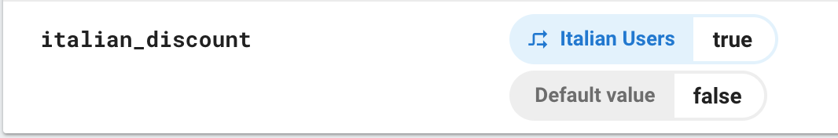
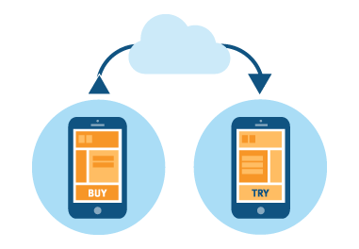
Using Remote Configs

Slide 23

Power of A/B Testing

Slide 24
App Indexing
Search Results
Installs
Autocompletions
Assistant
Ad Targeting
Notes:
Search results - App Indexing surfaces links to app content on Google Search. For Android, this includes an install button for your app as well as personal content results in the Google app.
Installs - The install button for your app appears next to your homepage search result, giving users an easy path to installing your app to view content.
Autocompletions - App Indexing on Android lets your users see app content directly from suggested results in the Google app.
Assistant - App Indexing powers public content results for screen search on Android and Google Assistant on Pixel and Allo.
Ad targeting - If you use AdMob to monetize your app, App Indexing and AdMob will work together to improve the quality of targeted ads for public content in your app, helping to drive increased advertising revenue.

Slide 25
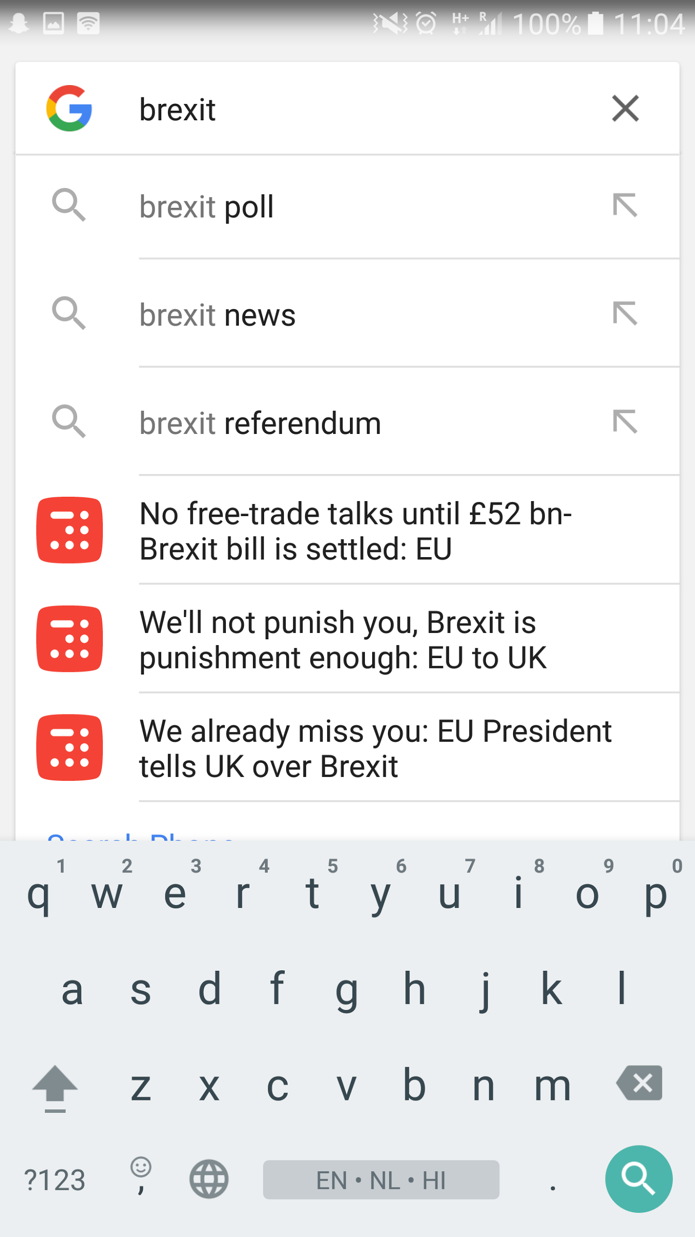

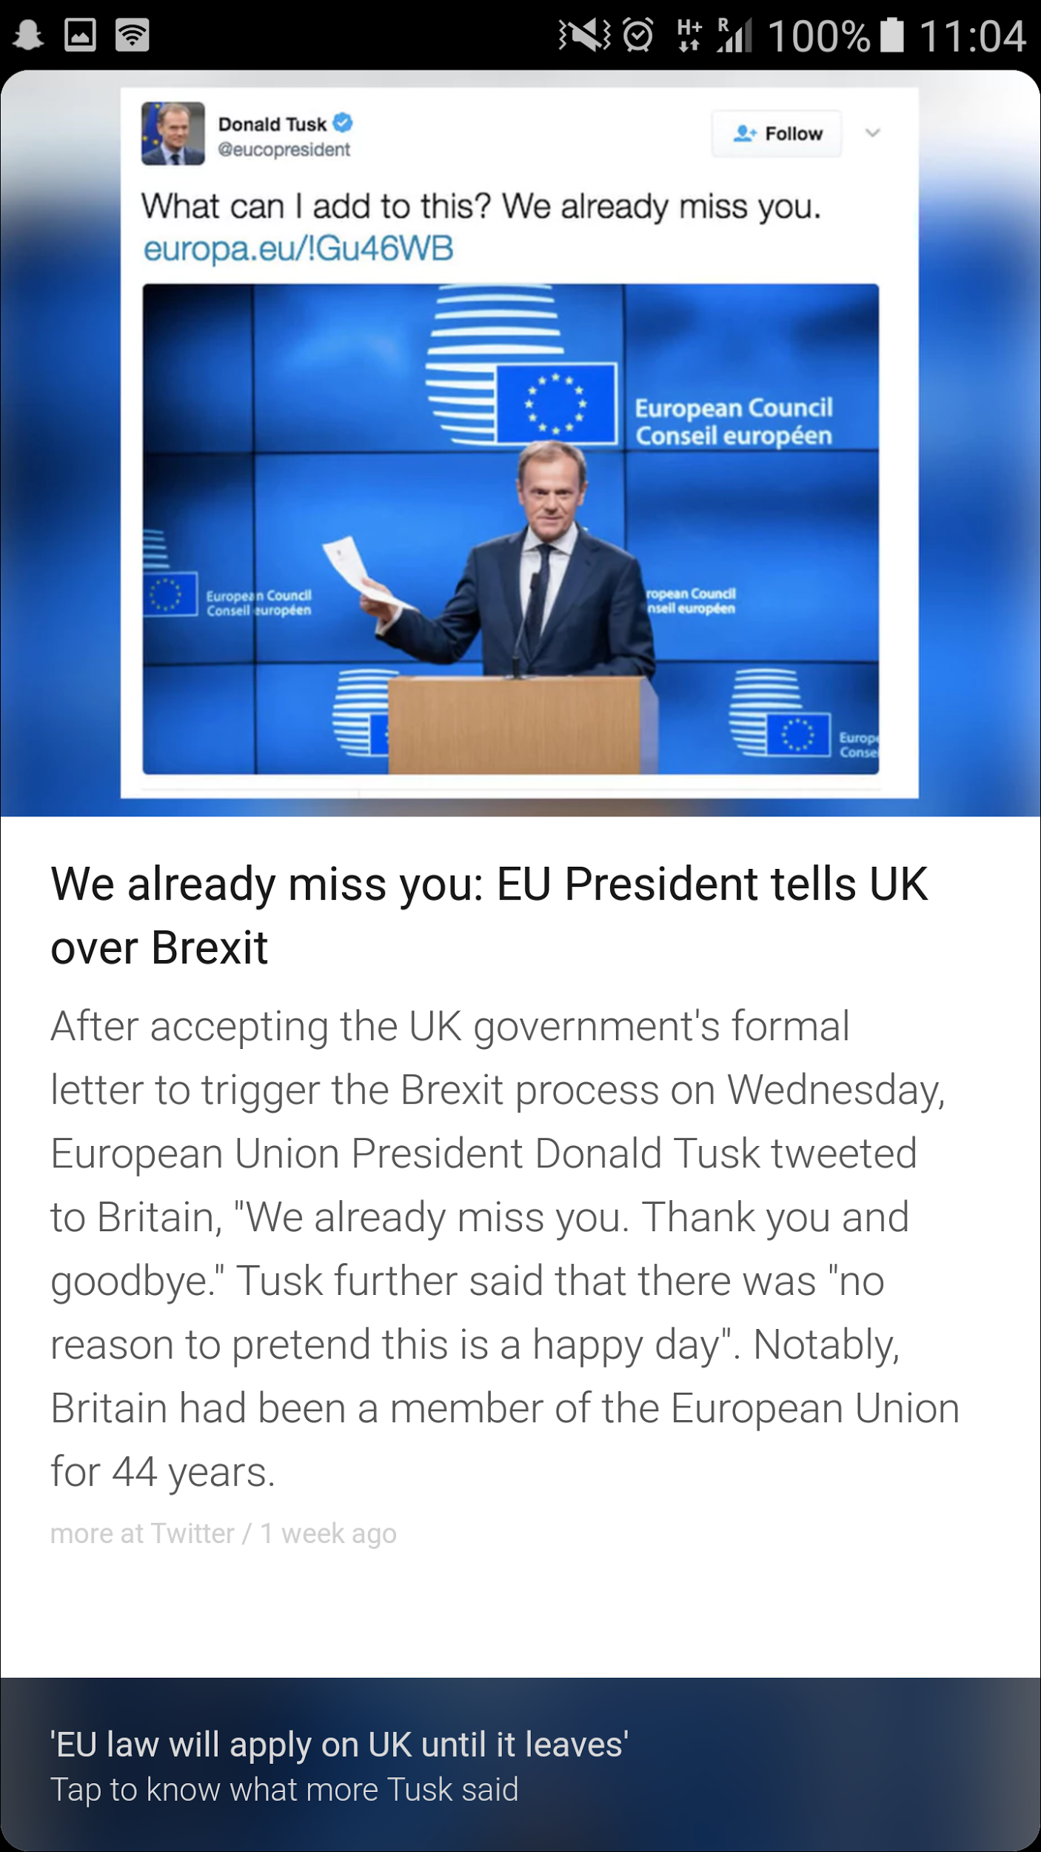
App Indexing in action
Notes:
The Irony of this slide is that, while I am telling you how to retain users into your app, UK is exiting the EU :(

Slide 26
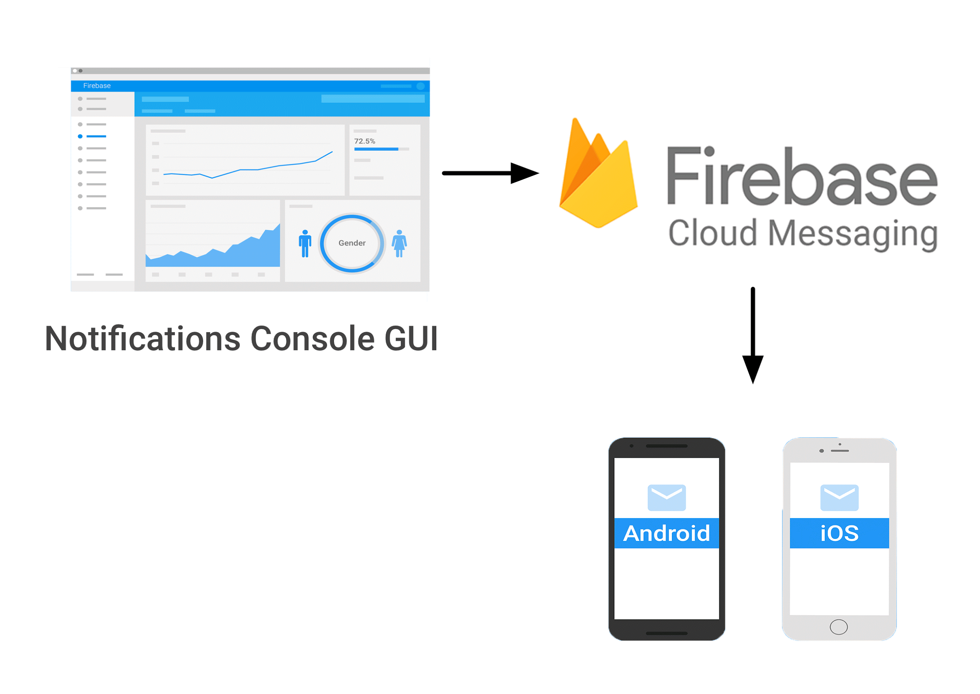
Notifications
Built on Cloud Messaging
Custom Audience Targeting
Topic wise broadcast
Single Device Push

Slide 27
Dynamic Links & Invites
Deep links for your content
Low friction for users
Installation flow survival
Higher Conversion

Slide 28
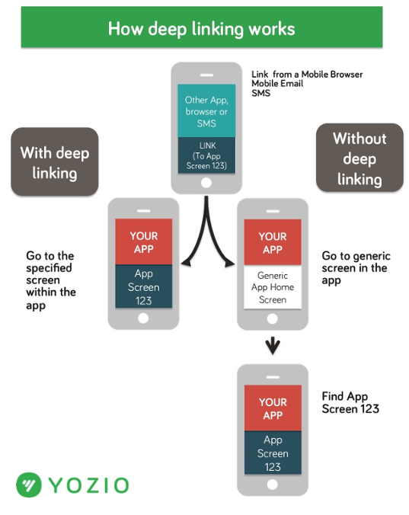
Deeplink in Action

Slide 29
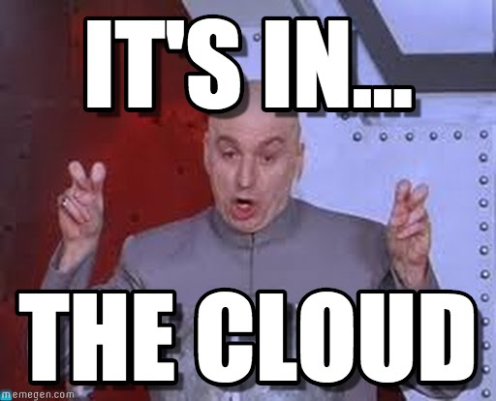
Test lab for Android
Test on the most popular devices before you ship.
Reports & Screenshots & Testing
Espresso, Robotium & UI Automator 2.0 Tests
Robo Tests with session video recording

Slide 30
Crash Reporting
Monitor non-fatal errors in Android
Setup email alerts for new crashes
Direct integration with Analytics - to get insights based on your audience

Slide 31

Not reporting crashes yet?

Slide 32
Need more info?
Documentation - firebase.google.com/docs/
Presentation - bit.ly/uberritos

Slide 33



ishan1604
@ishan1604

